Slide 1

Image Processing and Computer Vision TMC 303
Dr. Nisha Chandran S.
Associate Professor
School of Computing

Slide 2

Unit 1
Lecture 3

Slide 3
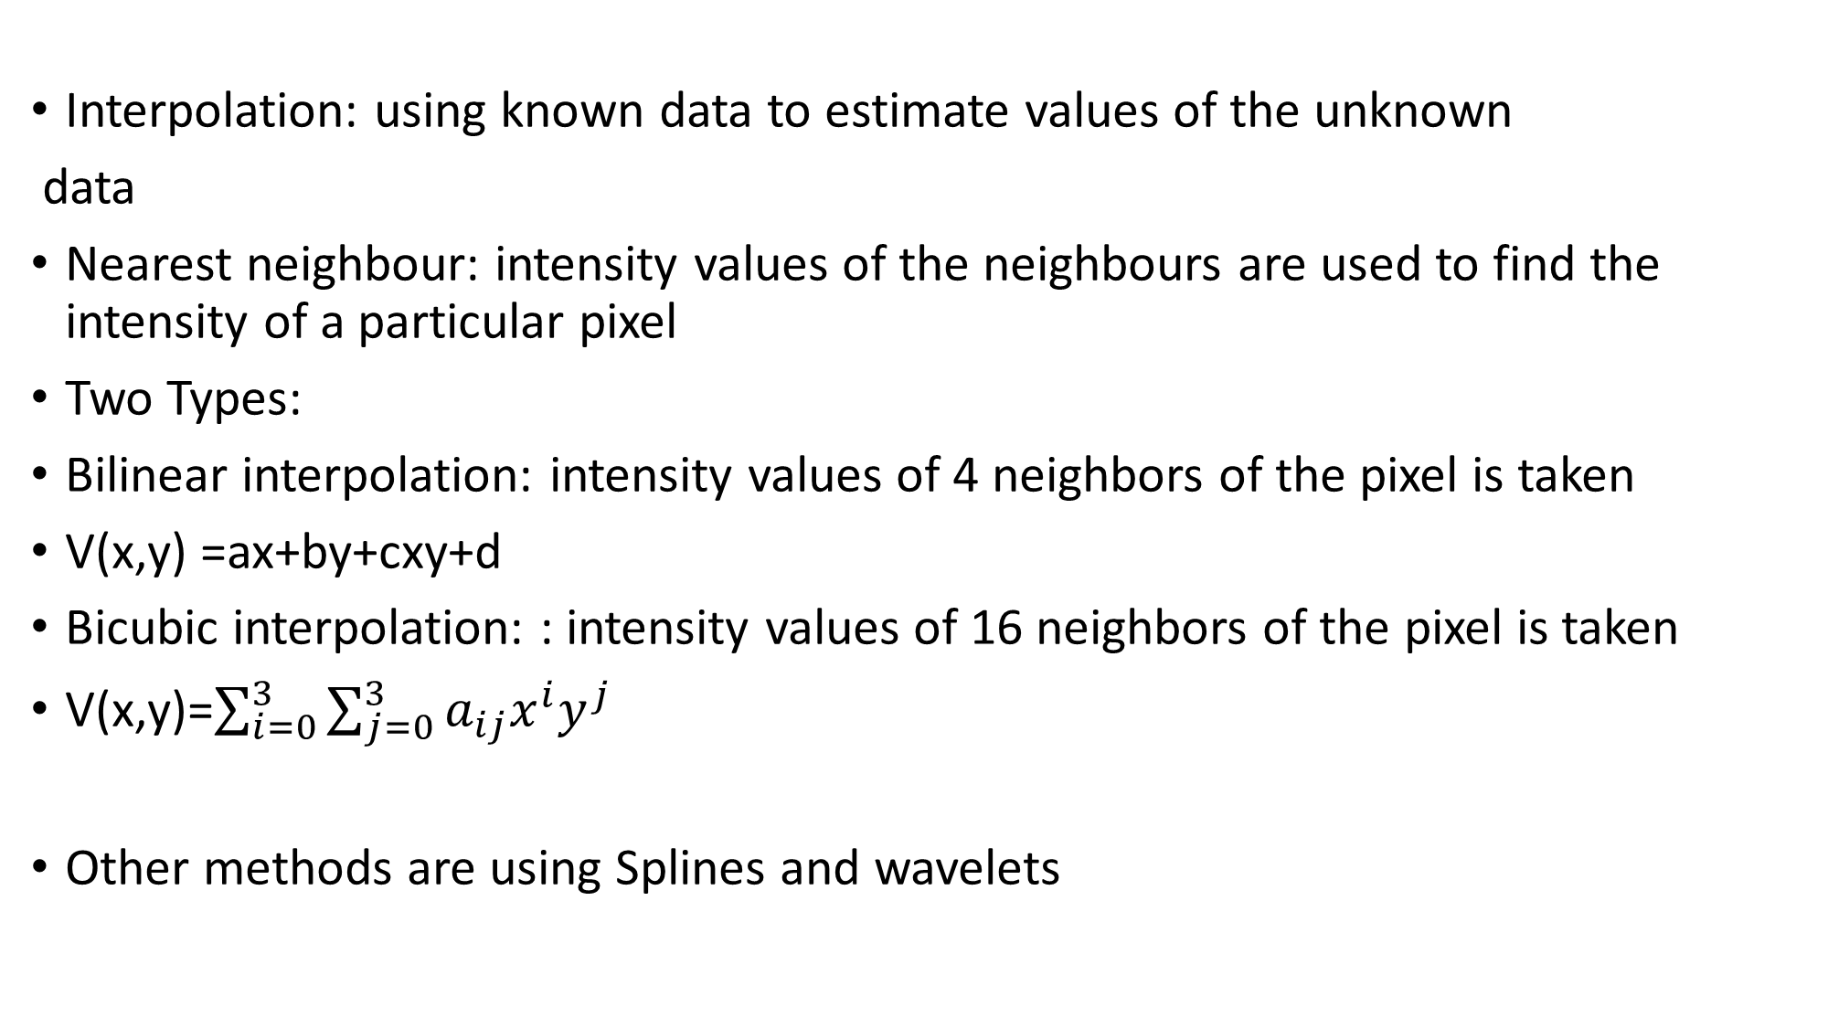
Interpolation: using known data to estimate values of the unknown
data
Nearest neighbour: intensity values of the neighbours are used to find the intensity of a particular pixel
Two Types:
Bilinear interpolation: intensity values of 4 neighbors of the pixel is taken
V(x,y) =ax+by+cxy+d
Bicubic interpolation: : intensity values of 16 neighbors of the pixel is taken
V(x,y)=$\sum_{i=0}^{3}{\sum_{j=0}^{3}{a_{ij}x^{i}y^{j}}}$
Other methods are using Splines and wavelets

Slide 4
Neighbors of a pixel
A pixel P at coordinates (x, y) has four horizontal and vertical neighbors
This set of 4 neighbors of P is called N₄(P)
Each pixel at unit distance from P
N₄(P) ={(x+1,y),(x-1,y),(x,y+1),(x,y-1)}
If P is a boundary pixel, then it will have less no. of neighbors
Set of image locations of the neighbors of a pixel point P is called the neighborhood of P
(x-1,y-1) | (x-1,y) | (x-1,y+1)
(x,y-1) | P(x,y) | (x, y+1)
(x+1,y-1) | (x+1,y) | (x+1, y+1)

Slide 5
Diagonal Neighbors of P : N_{D}(P)
Eight Neighbors: N₈(P)
N₈(P)= N₄(P)U N_{D}(P)
In case of boundary point less number of neighbors in N₈(P)
1 |  | 3
 | P
7 |  | 5
1 | 2 | 3
8 | P | 4
7 | 6 | 5

Slide 6
Connectivity
Used to find the property of a particular region in the image
Used in segmentation of image
Separate the point which belong to the object from that which do not belong
Based on thresholding
If f(x,y) > Threshold ; (x,y) belongs to the object
Else
(x,y) belongs to the background

Slide 7
Consider the binary image
Every background point will have a value 0 and the object point will have value 1
Threshold here is say 1
If f(x,y) =1 then it is an object point, all other points considered as background

Slide 8
How to find out the feature of the object?
Or how to find out pixels belonging to the same object?
We will have to group the pixels which belong to the objects
We use the concept of connectivity
Connectivity:
Two pixels are said to be connected if
they are adjacent in some sense.

Slide 9
Two pixels are connected if
They are neighbors N₈(P), N₄(P) or N_{D}(P)
Their intensity levels or gray levels are similar
For a binary image B two points p and q are connected if
q belongs to N(p) or p belongs to N(q)
Intensity(p)= intensity(q)

Slide 10
Let V be a set of gray levels used to define connectivity for two points p and q where f(p,q) belongs to V
i.e the intensity values at points p and q, f(p,q) belongs to V.
V={0,1}, if we are referring to connectivity with pixel values with 1
V={any subset between 0 to 255}, in gray scale image

Slide 11
Three types of connectivity are defined:
4 connectivity: intensity values of p,q belongs to V and q belongs to N₄(p)
8 connectivity: intensity values of p,q belongs to V and q belongs to N₈(p)
M connectivity: Mixed connectivity

Slide 12
M connectivity (Mixed connectivity):
Modification of 8 connectivity
intensity values of p,q belongs to V and points are M connected if
q belongs to N₄(p) or q belongs to N_{D}(p) and
N₄(p) ∩ N₄(q) = null set (has no pixels whose values are from V)
Set of pixels that are 4 neighbors of both p and q and the values are from v.
If the point q is a diagonal neighbor of p and if there are points which belongs to both N₄(p) and N₄(q) then M connectivity is not valid.

Slide 13
V={1}
0 | 1 | 1
0 | 1 | 0
0 | 0 | 1
0 | 1 | 1
0 | 1 | 0
0 | 0 | 1

Slide 14
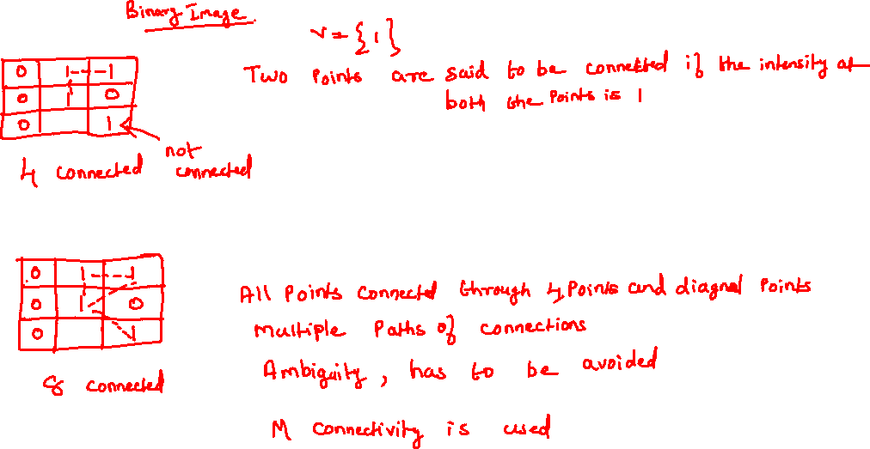

Slide 15
M connectivity
V={1}
0 | 1 | 1
0 | 1 | 0
0 | 0 | 1
0 | 1 | 1
0 | 1 | 0
0 | 0 | 1
M connectivity: multiple connections are ambiguous and must be avoided
N4(p) ={b,h,f,d}
N4(q)={b,f}
N₄(p) ∩ N₄(q) = {b}
So p and q are not M connected

Slide 16
Adjacency
If two pixels p and q are connected, then they are said to be adjacent
3 types of adjacency based on the connectivity is used
4- adjacency
Two pixels p and q with values from V are 4-adjacent if q is in the set N₄(p)
8-adjacency
Two pixels p and q with values from V are 8-adjacent if q is in the set N₈(p)
M-adjacency
Two pixels p and q with values from V are M-adjacent if
q is in the set N₄(p) or set N_{D}(p)
N₄(p) ∩ N₄(q) has no pixels whose values are from V

Slide 17
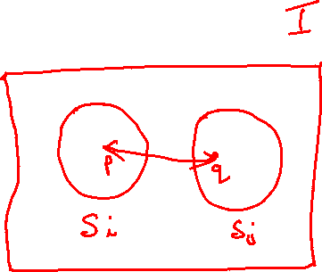
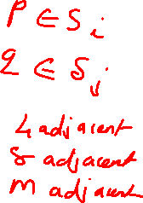
Adjacency can be extended to image regions
If there are two image subsets say S_{i} and S_{j} then they are said to be adjacent if
p belongs to S_{i}
q belongs to S_{j}
such that p and q are adjacent.

Slide 18
Digital Path
A digital path from p(x,y) and q(s,t) is a sequence of distinct pixels
Between p and q , there are a set of points say (x₀y₀ x₁y₁…x_{n}y_{n} )
which are adjacent to each other.
x_{i}y_{i} is adjacent to x_{i-1}y_{i-1} for every 1<i<n
Here the length of the path is n
If x₀y₀ = x_{n}y_{n} ,path is a closed path

Slide 19
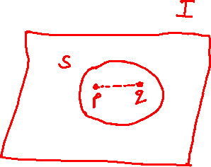
Connected Component
Let p and q be two points in the subset S of the image I
p and q are connected if there is a path from p to q consisting entirely of pixels from S
There can be many such connected points in S, they all form a connected component of S
If there is only one component and that component is connected, it is called a connected set

Slide 20
Region
Let R represent a subset of pixels in an image
R is a region of the image if R is a connected set
Two regions R1 and R2 are said to be adjacent if their union forms a connected set
We consider 4 and 8 adjacency when referring to regions
Regions which are not adjacent are said to be disjoint
Connected component concept is a fundamental step in automated image analysis.
Shape/area/boundary features can be extracted as region features.

Slide 21
Consider regions Ri and Rj
Union of two regions not a connected set

